Slide 1

Introduction to machine learning
Diamonds- predicting the price

Slide 2
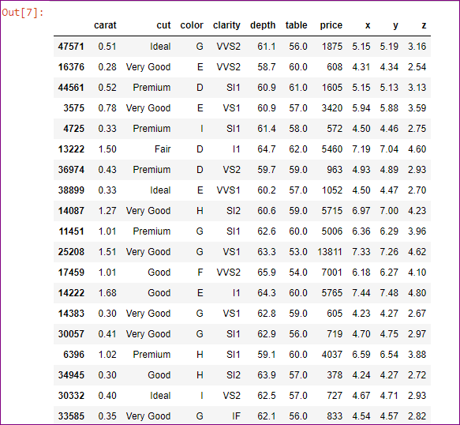
In the beginning... There was data. And it was categorical.

Slide 3
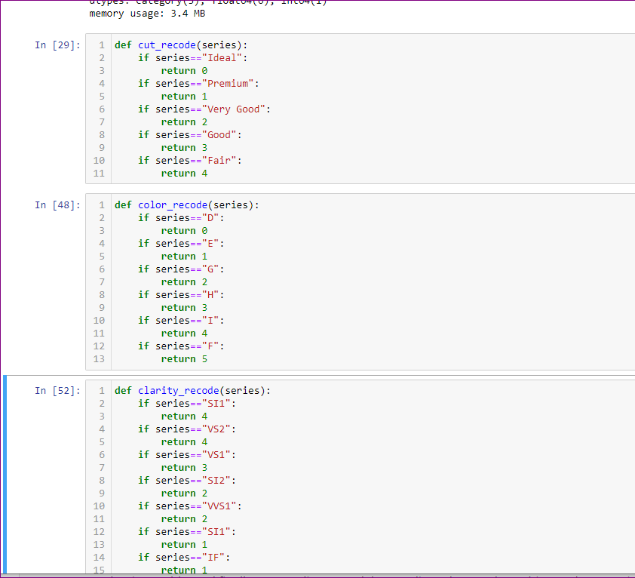
Then it was recoded
And now we can get to work

Slide 4

Price is being predicted based on the 4 C’s of diamonds: carat(size), cut, color and clarity

Slide 5
Since the size of this dataset is not very big the train/test will be done on a 60/40 split. So I will use 60% for training and 40% for testing. That is the plan.

